Slide 1



EMPLOYEE TURNOVER USING HR DATA
B.SAI ASHISH 12323855

Slide 2

CONTENT
PURPOSE
HYPOTHESIS
OBJECTIVES
METHODOLOGY
ANALYSIS
CONCLUSIONS

Slide 3






PURPOSE

Slide 4

PURPOSE
The purpose of predicting company turnover using HR data is to anticipate and understand the factors that contribute to employee turnover within a company. By analyzing HR data, such as employee demographics, performance evaluations, satisfaction surveys, and other relevant factors, companies can develop predictive models to identify patterns and potential reasons for turnover.

Slide 5

“CAUSE BABY NOW
WE GOT BAD BLOOD!”
-ANONYMOUS

Slide 6



HYPOTHESIS

Slide 7

HYPOTHESIS 1
HYPOTHESIS 2
a hypothesis could be that employee satisfaction levels, as measured through surveys or feedback, are negatively correlated with turnover rates. This would suggest that lower satisfaction levels are associated with higher turnover. Another hypothesis could be that the number of years an employee has been with the company has an inverse relationship with turnover, meaning that longer-tenured employees are less likely to leave the company.
the hypothesis could be that employees who receive lower performance ratings are more likely to leave the company, while those with higher ratings are more likely to stay. This hypothesis suggests that performance evaluations play a significant role in predicting turnover. Another hypothesis could be related to the impact of work-life balance on turnover, proposing that employees with better work-life balance are less likely to leave the company. These hypotheses can be further explored and tested using HR data to understand their implications for turnover prediction.

Slide 8
OBJECTIVES

Slide 9



STUDY OBJECTIVES
EDUCATION
DATAMANEGEMENT
DATA SCIENCE
FOCUS ON SIGNIFICANT PROBLEMS
HOW DATA FITS INTO PICTURE
RISK MITIGATION
COLLECTING OF DATA YEILD RESULTS
BUILDING DATA MANAGEMENT PROCESS
BENEFITS OF MACHINE LEARNING
DISTRUBUTING OBJECTIVES
MAKING DECESIONS WITH ML INSIGHTS

Slide 10
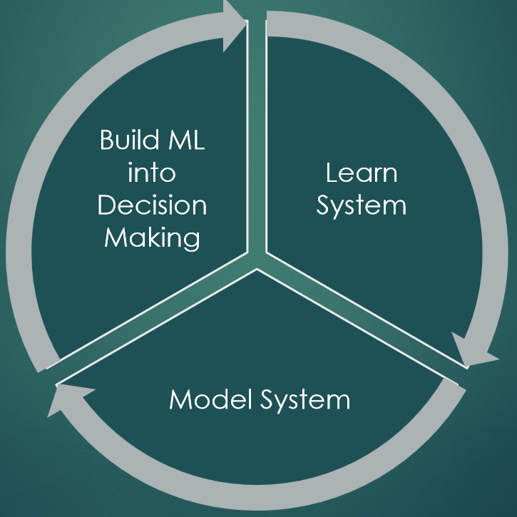

Slide 11
METHODOLOGY

Slide 12
METHODOLOGY
Data Collection
Data Preprocessing
Exploratory Data Analysis
Gather relevant HR data, including employee demographics, performance evaluations, salary information, tenure, satisfaction surveys, and any other factors that may be associated with turnover.
Clean the data, handle missing values, and prepare it for analysis. This may involve standardizing formats, normalizing data, and ensuring its quality.
Conduct an exploratory analysis to understand the relationships and patterns within the data. This may involve visualizations, correlation analysis, and identifying potential variables that may influence turnover.

Slide 13
METHODOLOGY
FEATURE SELECTION
MODEL SELECTION
MODEL TRANING
Identify the most relevant features (variables) that are likely to impact turnover. This can be done using statistical methods, domain knowledge, or machine learning techniques.
Choose an appropriate predictive modeling technique, such as logistic regression, decision trees, random forests, or neural networks, based on the nature of the data and the problem at hand.
Train the selected model using historical HR data, using a portion of the data to train the model and the rest to validate its performance.

Slide 14
METHODOLOGY
cross validatation
Cross-validation is a crucial technique in the study of predicting employee turnover using HR data. It involves partitioning the dataset into complementary subsets, performing the analysis on one subset (training set) and validating the analysis on the other subset (testing set). This process is then repeated multiple times, with each subset used exactly once as the testing set.
The primary benefit of cross-validation is that it allows for a more robust assessment of the model's performance. By using multiple iterations of training and testing on different subsets of the data, it helps to mitigate the risk of overfitting and provides a more accurate estimate of the model's ability to generalize to new data.

Slide 15
METHODOLOGY
BOOTS STRAP
Bootstrapping is a resampling technique often used in statistical analysis and predictive modeling, including studies on predicting employee turnover using HR data. In the context of such a study, bootstrapping involves creating multiple subsets of the original HR dataset by sampling with replacement. These subsets are then used to assess the variability of a predictive model's performance and to estimate the accuracy of its predictions.
One common application of bootstrapping in this context is to calculate confidence intervals for model performance metrics, such as accuracy, precision, recall, or the area under the receiver operating characteristic (ROC) curve. By repeatedly resampling the data and evaluating the model on each resampled dataset, researchers can obtain a distribution of performance metrics, which can be used to quantify the uncertainty associated with the model's predictions.

Slide 16
ANALYSIS

Slide 17
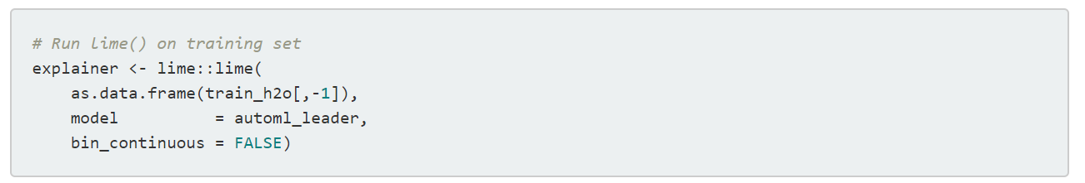
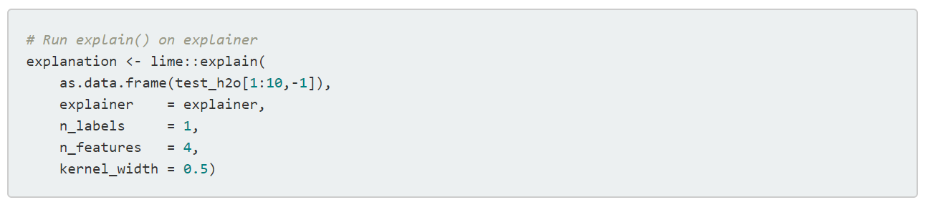
A
N
A
L
Y
S
I
S
Create explainer object
Explain new observations

Slide 18
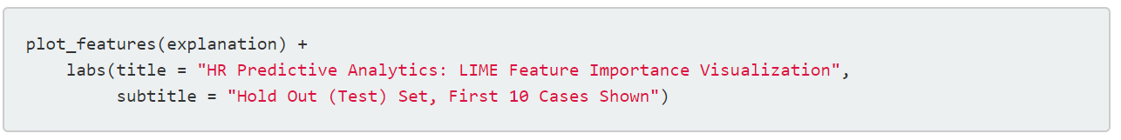
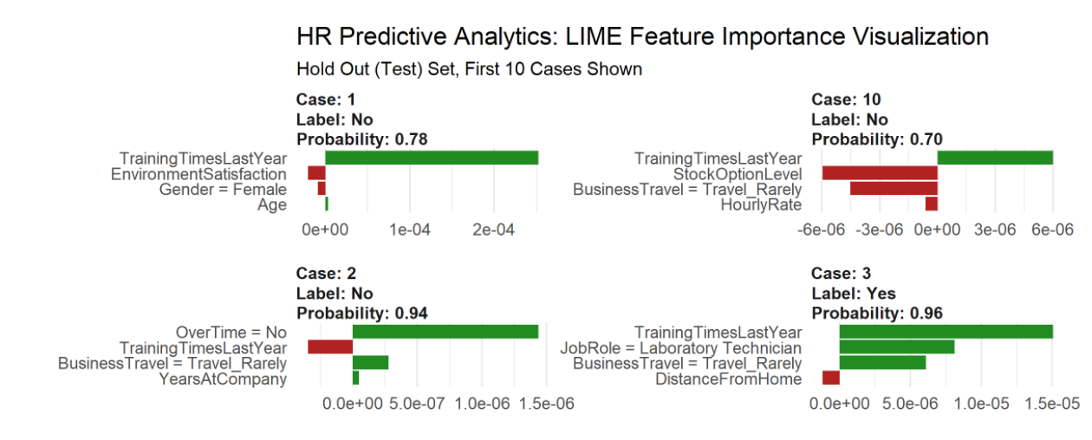
A
N
A
L
Y
S
I
S

Slide 19
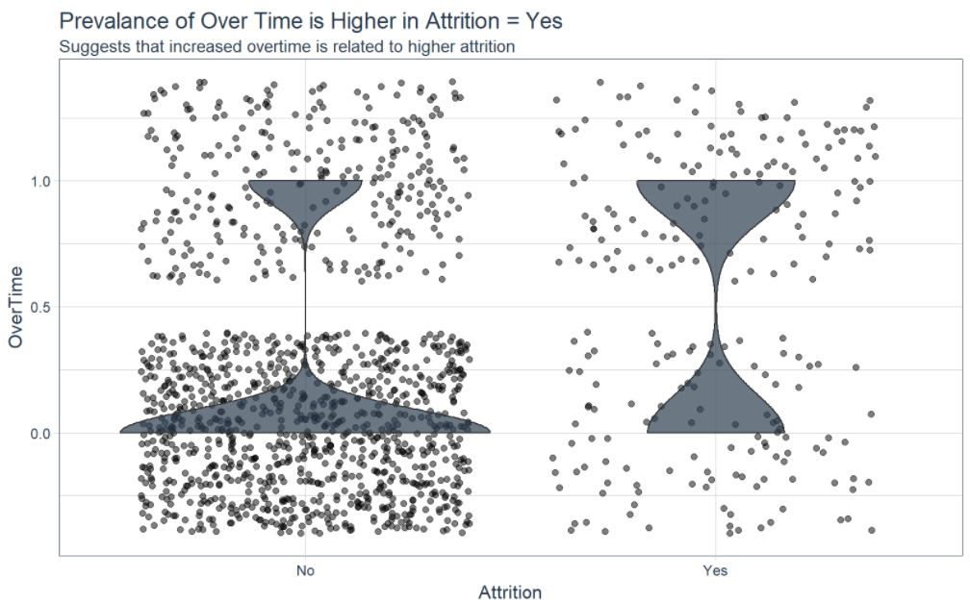
A
N
A
L
Y
S
I
S

Slide 20
CONCLUSIONS

Slide 21


70
ESTIMATED NUMBER OF AUDIENCE

Slide 22

CONCLUSION
CAN USE PREDICTIVE ANALYTICS & ML FOR HR PREDICTED TURNOVER 88% ACCURACY 62% RECALL IMPORTANT!
CAN EXPLAINED BLACK-BOX MODEL TURNOVER GREATER BASED ON JOB ROLE & OVERTIME
FRAME WORK FOR HIGH ACCURACY & EXPLAINABILITY

Slide 23
Through the analysis of various HR factors such as employee demographics, performance evaluations, satisfaction surveys, and tenure, valuable insights can be gained to understand the drivers of turnover and take proactive measures to mitigate its impact.
Key methodologies such as cross-validation and bootstrapping have been instrumental in assessing the performance and robustness of predictive models, providing researchers with a comprehensive understanding of the model's ability to generalize to new data and the variability of its predictions.
Overall, the study underscores the importance of utilizing HR data in predictive modeling to identify patterns, trends, and potential risk factors associated with employee turnover. By developing reliable predictive models, organizations can make informed decisions to enhance employee retention, improve workplace satisfaction, and ultimately contribute to a more stable and productive workforce. This study serves as a foundation for further research and practical applications in the field of HR analytics and employee turnover management.

Slide 24

KAL MILENGE THIK HAI KOI
QUESTIONS HAI KAL PUCHNA

Slide 25
THANK
YOU!

